Slide 1
Presentation of Findings
Group 4: Body

Slide 2
Overview
Shape and Size : Douglas Raymond
Materials: Nick Kamarianakis
Frame: Jacob Hawley
Lock Mechanism: Neal Traynor
Interior: Will Rose

Slide 3
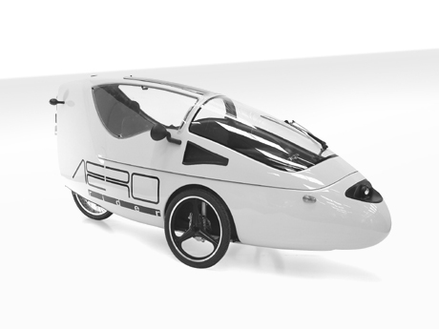
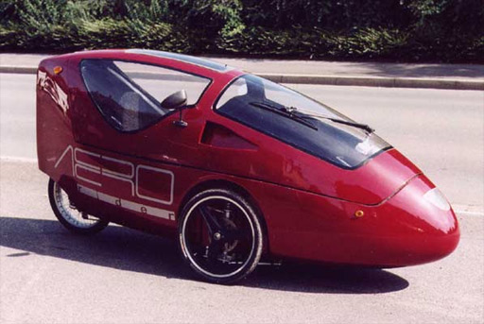
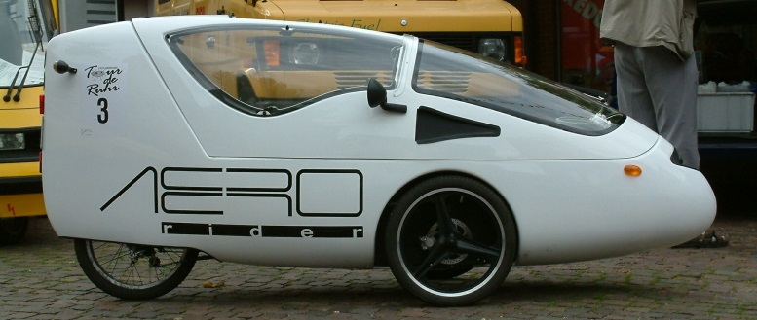
“What is the ideal shape and size for an electric assist bicycle?”
[1]
[2]
[3]

Slide 4
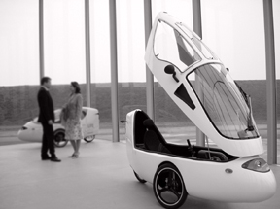
Doors
Spring loaded Gullwing doors
[4]

Slide 5
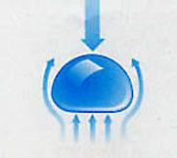
Shape
Aerodynamic like a raindrop
Dealing with rear tire snow buildup
Partially covered back wheel
Completely covered back wheel could collect a lot of snow
[5]

Slide 6
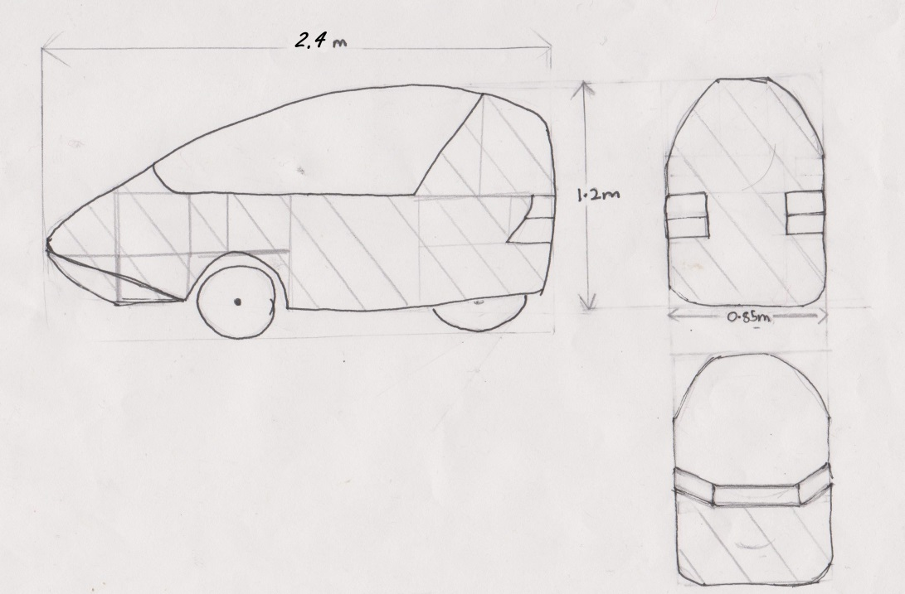
Dimensions
2.4m long by 0.85m wide by 1.20m high
Surface area: Front:(Pi x radius x slant height) + Back:(1.2x0.85)+ Sides:2 x(0.6x1.2) =1.75+1.02+1.44 <4.2 metre squared (-0.2metres squared per wheel)

Slide 7
Appearance
Customizable
Decals – Option of lower price
Paint job options – Better appeal

Slide 8
Materials
(1) Housings of Electrical Components
(2) Outer “Shell” of Vehicle
Engineering Principles:
Durability and Strength to Weight Ratio

Slide 9
Electrical Housings
Glass Filled Polycarbonate
Table 1 : Compressive strengths of Polycarbonate
Plastics International (2013) Zelux (Glass Filled Polycarbonate) [Online] Available: http://www.plasticsintl.com/datasheets/Polycarbonate_40_GF.pdf
http://www.youtube.com/watch?v=7TDnPLHXbyI

Slide 10

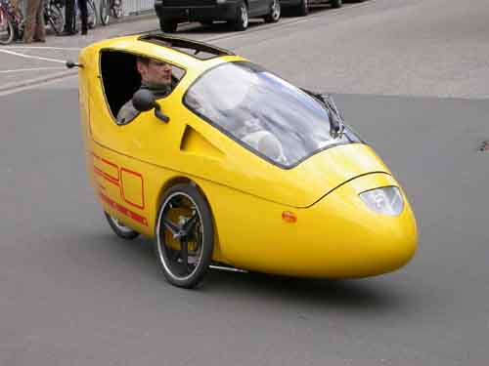
Outer Shell
Glass-Fiber Reinforced Polyester
[1] [2] [3]
[1] http://www.solarwebsite.nl/en/2007/08/proefrit-aerorider/
[2] http://www.velovision.com/showStory.php?storynum=607
[3] http://www.examiner.com/article/aerorider-the-ultimate-single-seat-hybrid
Total Weight: 16kg (4kg/m²)
Total Price: 60$ (15$/m²)

Slide 11
Frame
Force Distribution
Wheel Base
Seat Placement
Centre of Mass
Seat Height

Slide 12
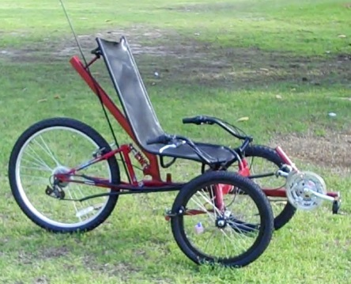
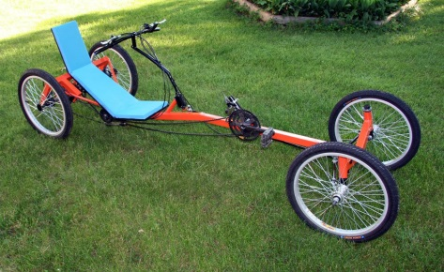
Wheel Base
Long→165-180cm
Short→83-114cm
Compact Long→114-165cm
120cm

Slide 13
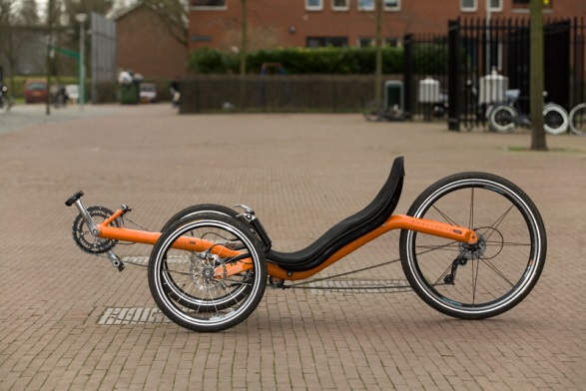
Seat Placement
70/30→ closer to the front tires
84cm
By the rear tire
Flip backwards
Less sturdy
By the front tires
Flip forward
Bumpy ride

Slide 14
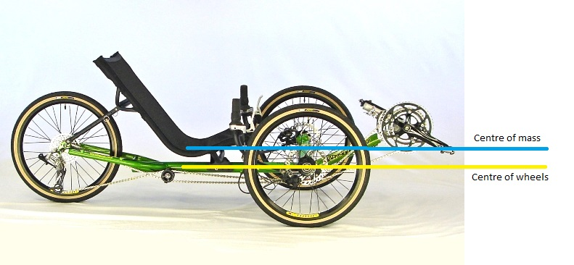
Seat Height
Even with the centre of tires
Good Visibility
Sturdy

Slide 15
Locking and Security
3 Principles:
Simplicity
Durability
Effectiveness
Primary option
Secondary option

Slide 16
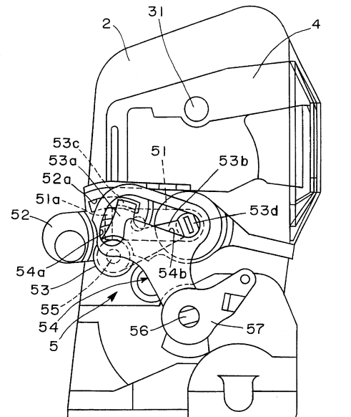
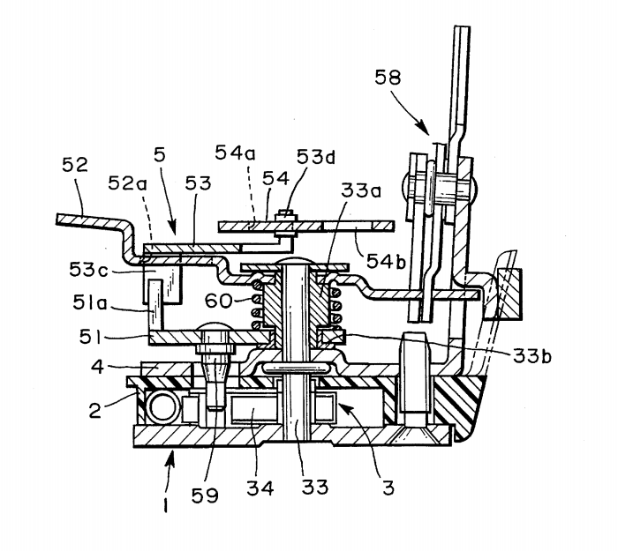
Primary Option
Primary option is to incorporate the existing vehicle door lock into the door of the recumbent tricycle

Slide 17
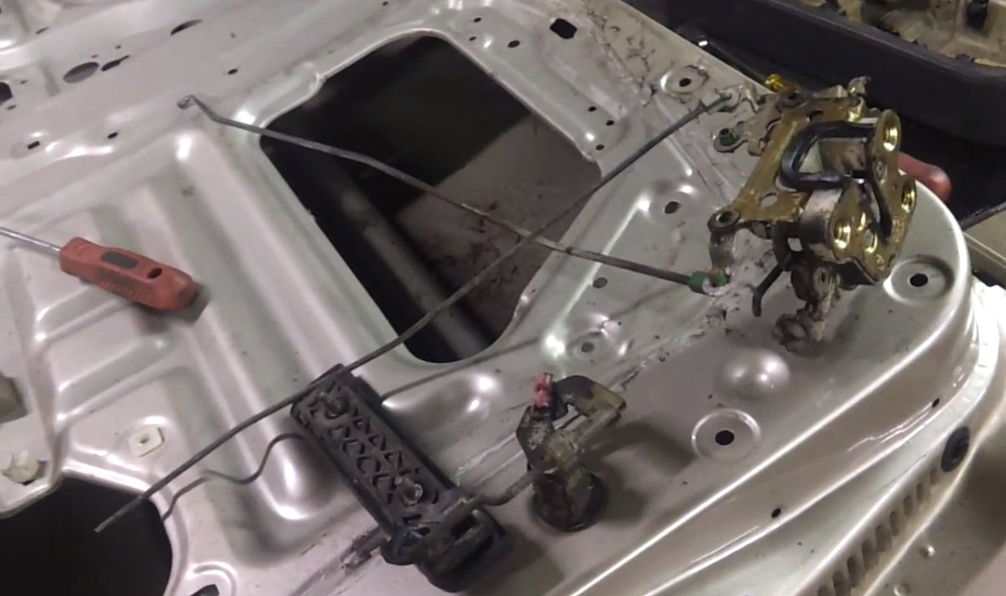

Slide 18
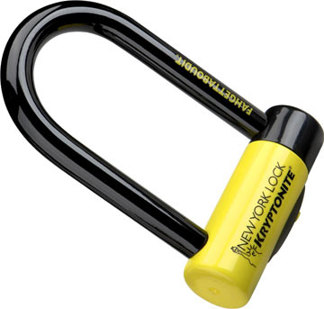
Secondary Option
Secondary option is to use a standard bike lock and attach it to either the frame or an exposed wheel

Slide 19
http://www.youtube.com/watch?v=I5pA_8Ut_J4
http://www.youtube.com/watch?v=8NK8zcZJif8

Slide 20
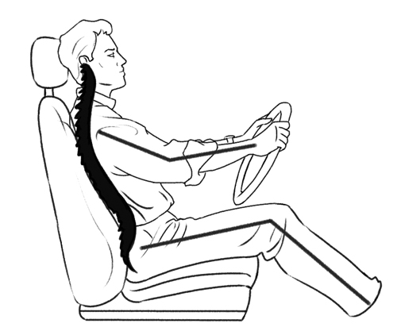
Ergonomics

Slide 21
Comfort

Slide 22
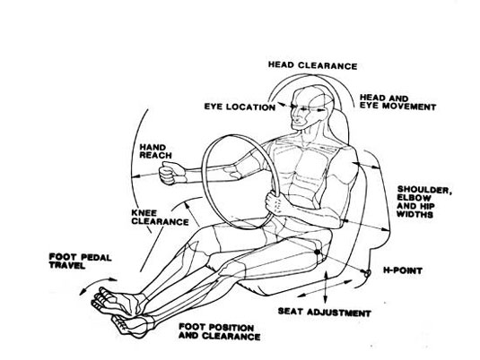
Adjustability

Slide 23
Adjustability

Slide 24
Thank you for your time
Questions?

